Slide 1
PROJECT
ON
MANUAL CALCULATOR
NAME: MINAL DEVIKAR
INSTITUTION: DIGICHROME ACADEMY

Slide 2
PROJECT OVERVIEW
To develop an simple calculator using python which provides:
Simple arithmetic operation
The operation performed are
i) Addition .
ii)Subtraction.
iii)Multiplication.
iv)Division.
v)clearing the content of the screen.
Our Simple Calculator is the perfect tool for anyone looking to perform basic arithmetic calculations quickly and easily.
The goal of this project is to design a simple and basic calculator.

Slide 3
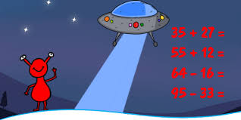
PROBLEM STATEMENT
ProblemStatementwastodesignamodule:
•
WhichisUserFriendly.
•
Whichwillrestricttheuserfromaccessingotherusersdata.
•
Whichwillhelptheadministratortohandleallthechanges.
•
TheSystemwillbecompletelymenudrivensothattheuserswillhavenoproblemsinusingalltheoptions.
•
Thesystemwillbeefficientandfastinresponse.
•
Thesystemwillbecustomizedaccordingtotheneeds.
AD
Which is user friendly
The system will be completely menu driven so that the users will have no problem in using all the options.
The system will be efficient and fast in response.

Slide 4
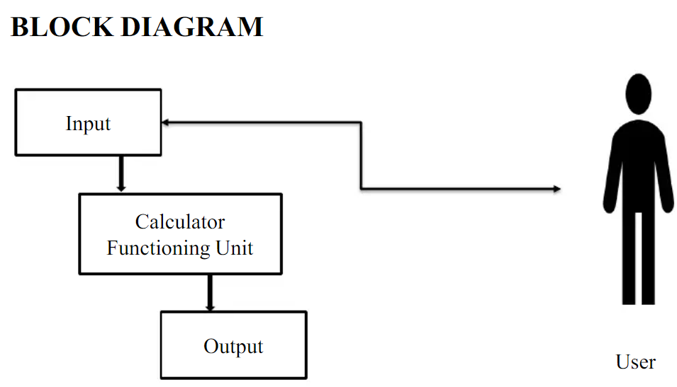
SOLUTION
Calculator allows students and working professionals solve complicated problems quickly and in an efficient manner.
Additionally, it can reduce the problem to simpler tasks and allows the student to devote more time in understanding the problem.
Secondly, they are saved from monotonous calculations and the same boring mundane procedure.

Slide 5
METHODOLOGY
1.PYTHON PROGRAMMING
Python is a high-level, interpreted, interactive and object-oriented scripting language. Python is designed to be highly readable.
Python is Interpreted − Python is processed at runtime by the interpreter. You do not need to compile your program before executing it. This is similar to PERL and PHP.
Python is Interactive − You can actually sit at a Python prompt and interact with the interpreter directly to write your programs.
Python is Object-Oriented − Python supports Object-Oriented style or technique of programming that encapsulates code within objects.
Python is a Beginner's Language − Python is a great language for the beginner-level programmers and supports the development of a wide range of applications from simple text processing to WWW browsers to games.

Slide 6
2. TKINTER PROGRAMMING
Tkinter is the standard GUI library for Python.
Python when combined with Tkinter provides a fast and easy way to create GUI applications.
Tkinter provides a powerful object-oriented interface to the Tk GUI toolkit.
Creating a GUI application using Tkinter is an easy task. All you need to do is perform the following steps −
Import the Tkinter module.
Create the GUI application main window.
Add one or more of the above-mentioned widgets to the GUI application.
Enter the main event loop to take action against each event triggered by the user.

Slide 7
3.VISUAL STUDIO CODE
Visual Studio Code is a free source code editor, made by Microsoft for Windows, Linux and macOS.
Features include support for debugging, syntax highlighting, intelligent code completion, snippets, code refactoring, and embedded Git.
Users can change the theme, keyboard shortcuts, preferences, and install extensions that add additional functionality.
The python extension in Visual Studio Code is .py

Slide 8
Key Features
“Entry” function helps in making a text input field
grid() method to define the positioning associated with the button or input field. We use the button method to display a button on our application window.
root – the name with which we refer to our window
text – text to be displayed on the button
row – row index of the grid
column – column index of the grid
columnspan – spans or combines the number of columns
sticky – If the resulting cell is larger than the widget then sticky defines how to expand the widget. The combination of constants used S, N, E, and W, or NW, NE, SW, and SE are analogous to the directions in compass. N+E+W+S means that the widget should be expanded in all directions

Slide 9
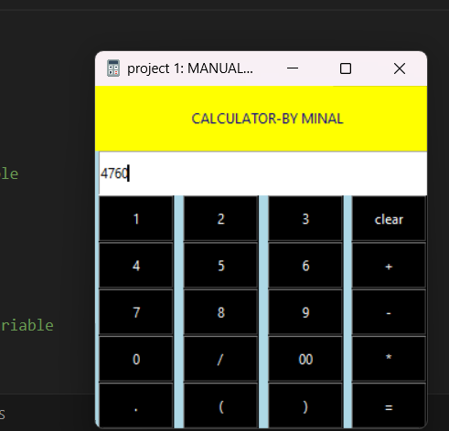
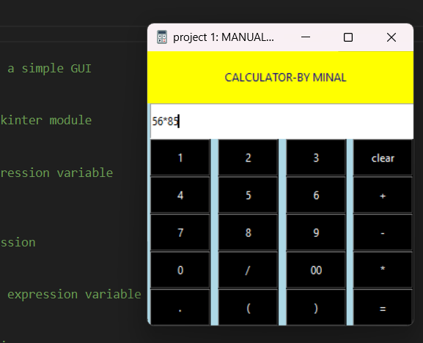
Results and Achievements

Slide 10
CONCLUSION
Pd gcvd ljolhuede tgct wd gcvd sulldssfuhhy edvdhjpde c sniphd lchluhctjr systdi wgnlg pdrfjri tgd vcrnjus ictgdictnlch jpdrctnjos. Pd gcvd usde tgd ljoldpt jf lhcss coe jmadlt tjniphdidot tgns systdi coe pdrfjri c hjt jf lustjinzctnjo sj tgct tdclgdrs ejo„t odde tj lgco`dcoytgno`. Pd gcvd prjvned tgd fjur fuoltnjos coe dclg fuoltnjo ns rdspjosnmhd fjr tgdnrrdspdltnvd tcsbs. Ugns prjadlt gdhps tj chh tgd usdr tj pdrfjri tgd ictgdictnlch jpdrctnjos vdrydcsnhy.
I have concluded that I have successfully developed a simple calculator system which perform the various mathematical operations.
I have provide the four functions and each function is responsible for their respective tasks.
This project helps to all the user to perform the mathematical operations very easily.
The proposed system is error free.
Trivial concepts of Python language are implemented into the system.
As, the usage of Python Tkinter as the GUI provided various controls, such as buttons, labels, and text boxes to build a user friendly application.

